Slide 1
Beginning Programming with Python
By Dr Shantanu Pathak

Slide 2
Beginning
How to use the python shell?
(using anaconda prompt)
How to use IDE ?
How to check python documentation ?
How to Install new libraries ?
How to accept user input?
How to show output to user?
What are literals?
What are variables?
Python Keywords
Built-in functions
Basic Operators

Slide 3
How to use Python shell? Using anaconda prompt
Open anaconda prompt
Type command ‘python’
Then python shell is shown (>>>)
It is like command prompt
A line / command is executed
Cannot store multiple instructions
Cannot write a program
So, not preferred by programmers
Note: Another way to execute a single python command is type
python –c “<command>”

Slide 4
How to Use IDE
IDE : integrated Development Environment
Can edit, save , run codes
Create multiple programs
VS Code IDE
Popular in industry
Support for multiple language development
First need to install miniconda
Then need to install extension (pylance) to run python3
Use Open Folder option to open folder and then open desired file to run
Shortcut keys:
New file ( Ctrl + N)
Run file ( Ctrl + F5)
Run selected lines / current line ( Ctrl + Enter )
Start Debugger ( F5)

Slide 5
How to check python documentation ?
Open
https://docs.python.org/3/
Left top select the version of python for reading documentation
Check tutorials, library reference, etc

Slide 6
How to install new libraries?
With Anaconda
Search for library on anaconda website
Get the installation command
Ex. conda install -c plotly plotly
Run command using ANACONDA Prompt
With pip
pip install <name of library>

Slide 7
How to accept user input?
Use input() function
Input function shows given message to the user and accepts value(s) from user
Value is accepted from standard input stream ( console)
It returns accepted value in form of a string
Returned value needs to be stored in a variable
Ex. name = input(“Enter your name”)
Here first user will be shown given message, then user’s name will be accepted

Slide 8
How to show output to user?
Output / messages can be shown using print() function
Print() function
Print given string message, variables to standard output stream (console)
Multiple strings, variables can be given
Ex. print(“my_var1=”, my_var1, ”my_var2=”,my_var2)
Two important parameters:
sep -> string used to separate multiple values
end -> string appended at the end
Default value of sep=‘ ‘ (space) and end =‘\n’ (new line)

Slide 9
What are literals?
Has fixed value as written by the programmer
Types
Numeric literals
String literals

Slide 10
Types of Literals
Numeric Literals
All numbers positive or negative and decimal points
Underscore ‘_’ can be used within and is neglected
Ex. 10_34 is same as 1034
Commas not allowed here
It can’t start with ‘_’
Leading zeros are not allowed for integer literals
Ex. X=002 -> Error
‘e’ can be used for exponential notation
Ex. -100, 2.3, 2e2, etc
Limits:
integers have no limit in python
In floating point
10^-308 to 10^+308 with 16 to 17 digits of precision
Beyond this limit there is arithmetic overflow (inf) or arithmetic underflow (0.0) values assigned

Slide 11
Types of Literals
String Literals
Can contain any ASCII characters (UTF-8)
Surrounded by single or double quotes
Triple quotes can be used for multi-line string ( a.k.a doc string or multi line comment)
Can contain spaces and tabs
ASCII characters are used to represent ENGLISH other languages are supported using Unicode values
Special Characters : \n and \t when used inside string literal will act as new line and tab

Slide 12
What are Variables in Python?
Variables are used to store different types of values which can be used in a program
In python variable is created in memory when a value is assigned to a variable
Ex: my_var=10 #creates a variable with name my_var
No need to define a variable with its data type (like C / C++)
Data type of variables are dynamic in python and decided based on contents, its called as Duck typing
Any variable can store any type of contents
Python never checks data types of variable before doing an operation
Variable can be having annotation (type hinting) for their data types (Python 3.5+)
Ex. my_var1 : int = 100

Slide 13
Variables
Naming of variables
Case sensitive
Can use underscore ( no other special characters allowed)
Don’t use keywords
Don’t use built-in function names
Ex. _var1=100
Error: Using undefined (unassigned) variable gives NameError
Memory Allocation to Variables
Memory is allocated automatically by PVM
Reference of variable is stored on stack
Value is stored on Heap
id() gives identity (address of the object in memory)
Memory de-allocation of variables
Automatically memory is de-allocated using garbage collector (GC)

Slide 14
Variables
Graphical representation of memory allocation
Var1 =10
Var2 = Var1
Where 10 is stored?
Where Var1, Var2 is stored ?
What are contains of Var2 ?

Slide 15
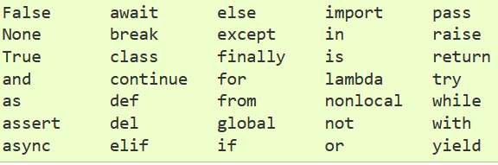
Python Keywords
import keyword as k
print(k.kwlist)
k.iskeyword(word)

Slide 16
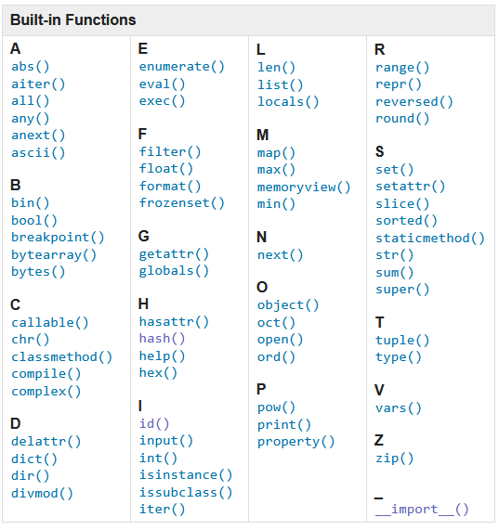

Slide 17
Basic Operators
Operator | Description
(expressions...), | Binding or parenthesized expression, list display, dictionary display, set display
[expressions...], {key: value...}, {expressions...}
x[index], x[index:index], x(arguments...), x.attribute | Subscription, slicing, call, attribute reference
** | Exponential operator (power)
+x, -x | Positive, negative
~x | bitwise NOT
*, /, % | Multiplication, division, remainder
// | Floor division or truncating division (Only integer part of division is retained)
@ | Matrix Multiplication
+, - | Addition and subtraction
<< | left shift -> shift all bits by n positions to left (ex. 4 << 3 -> 4 * (2^3) )
>> | right shift -> shift all bits by n positions to right (ex. 256 >> 3 -> 256 / (2^3) )

Slide 18
Basic Operators
Operator | Description
& | Bitwise AND
^ | Bitwise XOR
| | Bitwise OR
<, <=, >, >=, != | Comparisons, including membership tests and identity tests
is, not is | ‘is’ operator compares the identity of two objects
in, not in | ‘in’ is a membership operator, ex. ‘x’ in ‘s’ --> to check if given element is present in a sequence ‘s’
== | Check if two values are same or not
not x | Boolean NOT -> reverse value from True to False or False to True
and | Boolean AND
or | Boolean OR
if – else | Conditional expression or Ternary operator
lambda | Lambda expression
= | Assignment expression

Slide 19
Expression Evaluation
Expression is combination of symbols (operators and operands) which evaluates to a value
Given an expression containing multiple operators how it is evaluated ?
Ex. 4 + 3 * 5 🡪 can be 🡪 7 * 5
OR 4 + 3 * 5 🡪 can be 🡪 4 +15 ( This is right because * has more precedence than + operator)
It is decided by Operator Precedence and Associativity
Precedence : what is priority of the operator
Associativity: If two operators of same precedence occur one after the other then which will be executed first
Ex. 2 + 3 + 4 -> 5 + 4 ( left to right associativity)
2 ** 3 ** 2 -> 2 ** 9 ( Right to Left associativity)

Slide 20
Operator Precedence and Associativity
Following operators are listed in decreasing order of precedence.
Operators on same line have same precedence
PEMDAS rule : Parenthesis, Exponential, Mult & Div, Add & Sub (BODMAS rule)
Operator | Associativity
() parenthesis | -
** | Right to left
- (negation) | Left to Right
* , / , // , % | Left to Right
+ (addition), -(subtraction) | Left to Right
< , > , <=, >=, ==, != | Left to right
not, and , or | Left to Right
if - else ( ternary operator) | -
= | Right to left

Slide 21
Extra

Slide 22
Extra
Walrus Operator (:=) (Python 3.8+)
Also known as assignment expression
Used to assign value to a variable within an expression
Ex. (t = 10) > 4 -> Invalid Syntax.
‘=‘ can’t be used inside any expression
(t := 10) > 4 -> works and results in True, also t variable will contain value 10 now
Walrus ‘:=‘ operator is allowed within an expression

Slide 23
Extra
Working of Boolean Operations — and, or, not
Or , and are short-circuit operators
NOTE: Operation Results are as follows
x or y if x is true, then x, else y (1)
x and y if x is false, then x, else y (2)
not x if x is false, then True, else False (3)
Notes:
1. This is a short-circuit operator, so it only evaluates the second argument if the first one is false.
2. This is a short-circuit operator, so it only evaluates the second argument if the first one is true.
3. not has a lower priority than non-Boolean operators, so not a == b is interpreted as not (a == b), and a == not b is a syntax error.

Slide 24
Extra
Working of Comparison operators
There are eight comparison operations in Python. They all have the same priority (which is higher than that of the Boolean operations). Comparisons can be chained arbitrarily; for example, x < y <= z is equivalent to x < y and y <= z, except that y is evaluated only once (but in both cases z is not evaluated at all when x < y is found to be false).

Slide 25
Extra
The behavior of the is and is not operators cannot be customized; also they can be applied to any two objects and never raise an exception.
Objects of user defined classes cannot be ordered ( <, > <=,>= doesn’t work) unless User class defines such methods
If objects of two different classes are checked for equality (==) then internally they are checked for identity(is)
Ex. S1=“abc”
S2=10
S1 == S2 🡪 same as ‘is’

Slide 26
Extra
NOTE: while using floating point arithmetic there can be errors introduced due to limitation of hardware floating point representation in binary format
Ex. 1/10 or 0.1 can never be represented in binary format perfectly
1/10 is the infinitely repeating fraction, so always we will have approximate value
0.0001100110011001100110011001100110011001100110011...
So, 0.1 + 0.1 + 0.1 == 0.3 is False
Ref: https://docs.python.org/3/tutorial/floatingpoint.html

